Slide 1

Automata Theory (ITC404)
VES INSTITUTE OF TECHNOLOGY
DEPARTMENT OF INFORMATION TECHNOLOGY
BY
Mrs Charusheela Nehete
Assistant Professor,
IT Department ,
VESIT

Slide 2
Regular Expression ( R.E .)
The languages accepted by FA are described or defined using simple expressions called as “Regular Expressions”.

Slide 3
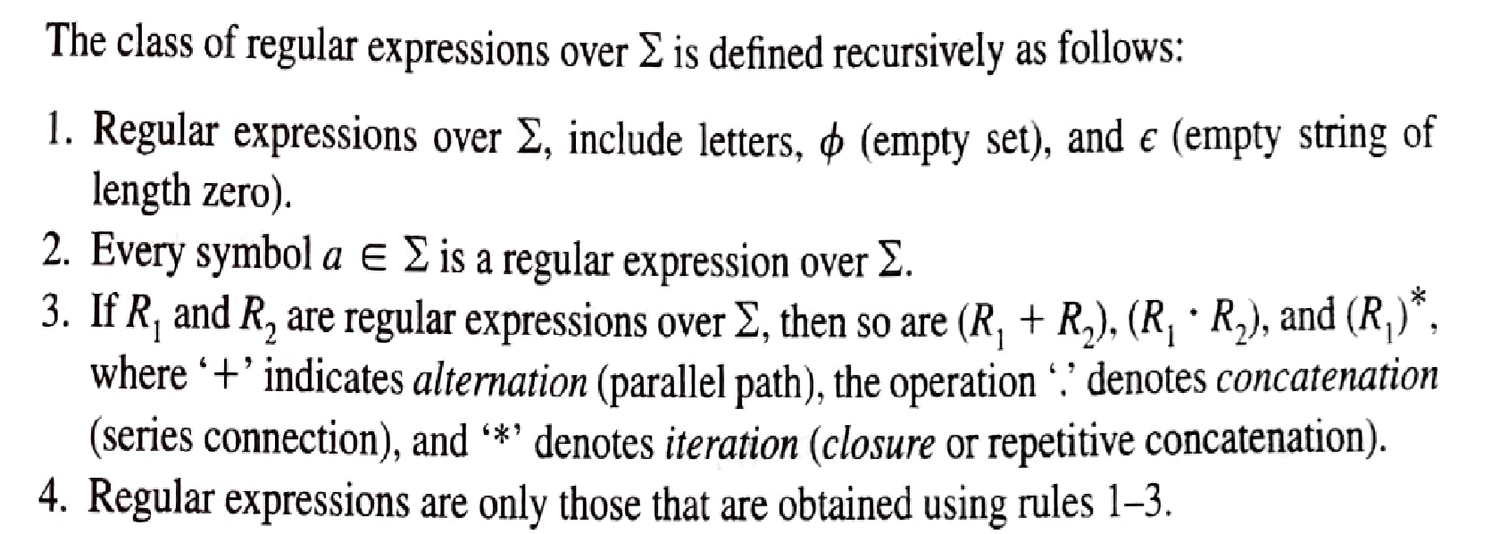
Formal Definition of Regular Expression ( R.E.)

Slide 4





Notations
.

Slide 5
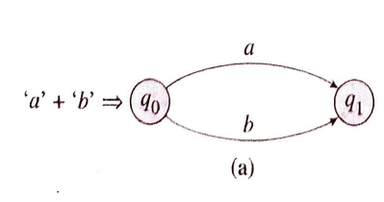
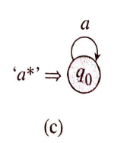


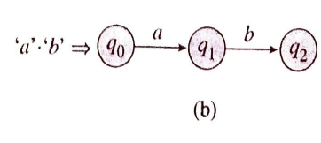

Transition Graphs

Slide 6
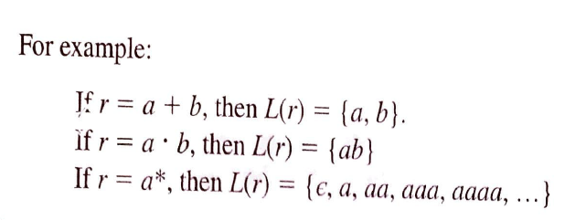
Language

Slide 7
Examples of Writing Regular Expressions for representing given language

Slide 8
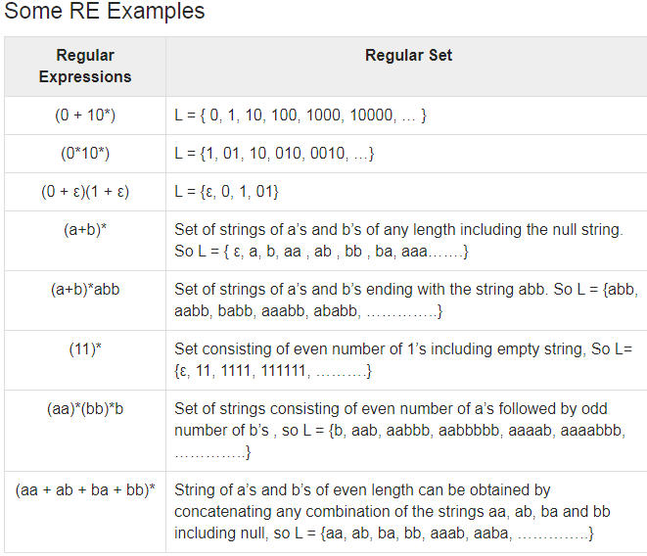

Slide 9

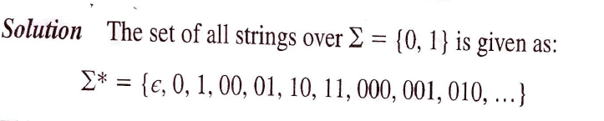

Examples of Regular Expressions

Slide 10
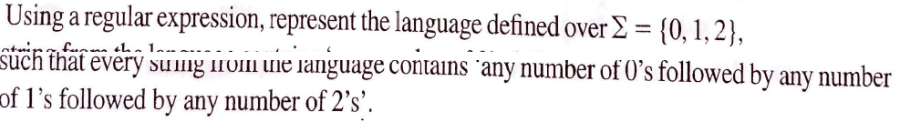

Example 2:

Slide 11
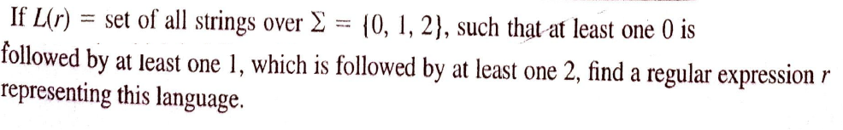
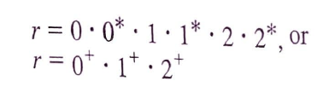
Example 3

Slide 12
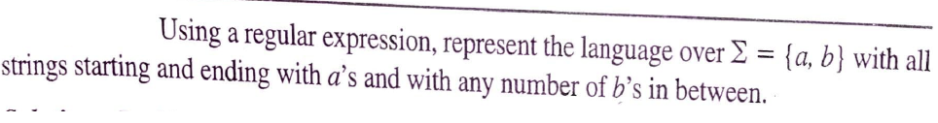


Example 4

Slide 13



Example 5

Slide 14
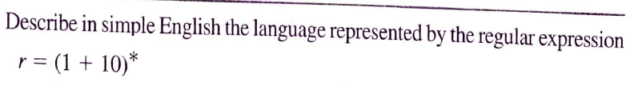

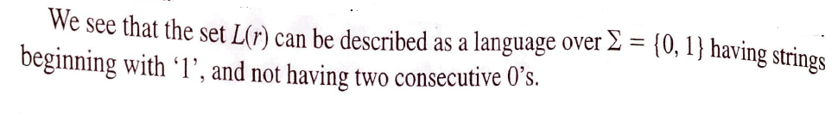
Example 6

Slide 15
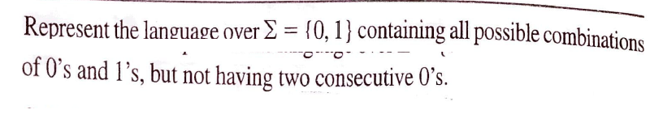




Example 7
Strings start with 1 and with no two consecutive 0’s
Strings start with 0 and with no two consecutive 0’s

Slide 16


Example 8

Slide 17

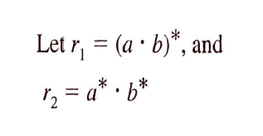

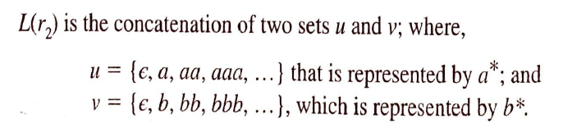
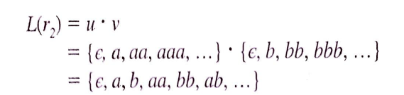

Example 9

Slide 18


Example 10

Slide 19

Example 11

Slide 20
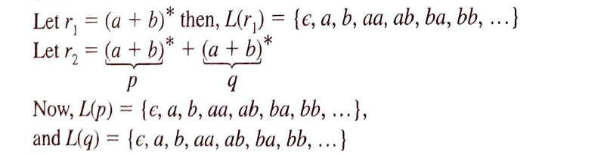
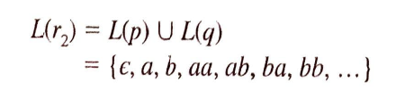

Example 12

Slide 21
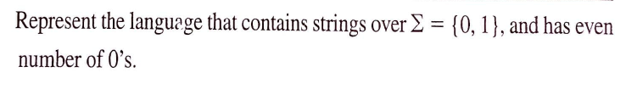

Example 13

Slide 22
Exercises
L := {w ∈ {a, b}∗ | |w| divisible by 3}
((a + b) · (a + b) · (a + b))∗
2. L := {w ∈ {a, b}∗ | starts and ends with same character}
a (a+b)*a + b(a+b)*)
3. L := {w ∈ {0, 1}∗ | no of 0 divisible by 3}
1* + (1* 0 1* 0 1*01)*
L := {w ∈ {0, 1}∗ | starts with 0 and has odd length, or starts with 1 and has even length }
5. All strings which do not contain the substring ba.
a ∗ b ∗
0((0+1) (0+1))* + 1(0+1)((0+1)(0+1))*

